Slide 1
Agenda
Threads Overview
Creating threads in Java
Synchronization
wait() and notify()
Thread Pools
Exercise

Slide 2
Threads Overview
  – Threads allow the program to run tasks in parallel
  – In many cases threads need to be synchronized,
  that is, be kept not to handle the same data in memory concurrently
  – There are cases in which a thread needs to wait for another thread before proceeding
  Never use thread-per-session – this is a wrong and un-scaled architecture – use instead Thread Pools

Slide 3
Agenda
Threads Overview
Creating threads in Java
Synchronization
wait() and notify()
Thread Pools
Exercise

Slide 4
Threads in Java
Option 1 – extending class Thread:
public class Thread1 extends Thread {
@Override
public void run() {
System.out.println("Thread1 ThreadId: " + Thread.currentThread().getId());
// do our thing
PrintNumbers.printNumbers();
// the super doesn't anything,
// but just for the courtesy and good practice
super.run();
}
}
Notes:
Using the Thread class directly has the following disadvantages.
Creating a new thread causes some performance overhead.
Too many threads can lead to reduced performance, as the CPU needs to switch between these threads.
You cannot easily control the number of threads, therefore you may run into out of memory errors due to too many threads.
The java.util.concurrent package offers improved support for concurrency compared to the direct usage of Threads

Slide 5
Threads in Java
Option 1 – extending class Thread (cont’):
static public void main(String[] args) {
System.out.println("Main ThreadId: " + Thread.currentThread().getId());
for(int i=0; i<3; i++) {
new Thread1().start(); // don't call run! // (if you want a separate thread)
}
printNumbers();
}

Slide 6
Threads in Java
Option 2 – implementing Runnable:
public class Thread2 implements Runnable {
@Override
public void run() {
System.out.println("Thread2 ThreadId: " + Thread.currentThread().getId());
// do our thing
PrintNumbers.printNumbers();
}
}

Slide 7
Threads in Java
Option 2 – implementing Runnable (cont’):
static public void main(String[] args) {
System.out.println("Main ThreadId: " + Thread.currentThread().getId());
for(int i=0; i<3; i++) {
new Thread(new Thread2()).start();
// again, don't call run!
// (if you want a separate thread)
}
printNumbers();
}

Slide 8
Threads in Java
Option 3 – implementing Runnable as Anonymous:
static public void main(String[] args) {
System.out.println("Main ThreadId: " + Thread.currentThread().getId());
new Thread(new Runnable() {
@Override
public void run() {
System.out.println("Thread3 ThreadId: " + Thread.currentThread().getId());
// do our thing
printNumbers();
}
}).start(); // don't call run! ...
printNumbers();
}
Notes:
public void run(): is used to perform action for a thread.
public void start(): starts the execution of the thread.JVM calls the run() method on the thread.
public void sleep(long miliseconds): Causes the currently executing thread to sleep (temporarily cease execution) for the specified number of milliseconds.
public void join(): waits for a thread to die.
public void join(long miliseconds): waits for a thread to die for the specified miliseconds.
public int getPriority(): returns the priority of the thread.
public int setPriority(int priority): changes the priority of the thread.
public String getName(): returns the name of the thread.
public void setName(String name): changes the name of the thread.
public Thread currentThread(): returns the reference of currently executing thread.
public int getId(): returns the id of the thread.
public Thread.State getState(): returns the state of the thread.
public boolean isAlive(): tests if the thread is alive.
public void yield(): causes the currently executing thread object to temporarily pause and allow other threads to execute.
public void suspend(): is used to suspend the thread(depricated).
public void resume(): is used to resume the suspended thread(depricated).
public void stop(): is used to stop the thread(depricated).
public boolean isDaemon(): tests if the thread is a daemon thread.
public void setDaemon(boolean b): marks the thread as daemon or user thread.
public void interrupt(): interrupts the thread.
public boolean isInterrupted(): tests if the thread has been interrupted.
public static boolean interrupted(): tests if the current thread has been interrupted.

Slide 9
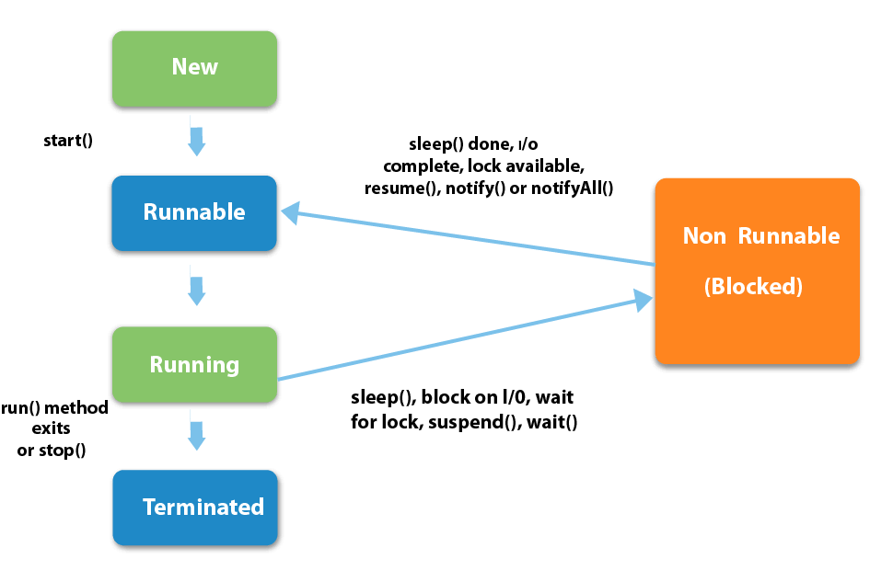
Thread Lifecycle
Notes:
1) New
The thread is in new state if you create an instance of Thread class but before the invocation of start() method.
2) Runnable
The thread is in runnable state after invocation of start() method, but the thread scheduler has not selected it to be the running thread.
3) Running
The thread is in running state if the thread scheduler has selected it.
4) Non-Runnable (Blocked)
This is the state when the thread is still alive, but is currently not eligible to run.
5) Terminated
A thread is in terminated or dead state when its run() method exits.

Slide 10
Agenda
Threads Overview
Creating threads in Java
Synchronization
wait() and notify()
Thread Pools
Exercise

Slide 11
Synchronization
  Synchronization of threads is needed for in order to control threads coordination, mainly in order to prevent simultaneous operations on data
  For simple synchronization Java provides the synchronized keyword
  For more sophisticated locking mechanisms, starting from Java 5, the package java.concurrent.locks provides additional locking options, see: http://java.sun.com/javase/6/docs/api/java/util/concurrent/
  locks/package-summary.html

Slide 12
Synchronization
Example 1 – synchronizing methods:
public class SynchronizedCounter {
private int c = 0;
public synchronized void increment() { c++; } public synchronized void decrement() { c--; } public synchronized int value() { return c; }
}
  The synchronized keyword on a method means that if this is already locked anywhere
  (on this method or elsewhere) by another thread,
  we need to wait till this is unlocked before entering the method
Reentrant is allowed

Slide 13
Synchronization
Example 2 – synchronizing blocks:
public void addName(String name) { synchronized(this) {
lastName = name;
nameCount++;
}
nameList.add(name);
}
  When synchronizing a block, key for the locking should be supplied (usually would be this)
  The advantage of not synchronizing the entire method is efficiency

Slide 14
Synchronization
Example 3 – synchronizing using different locks:
public class TwoCounters {
private long c1 = 0, c2 = 0;
private Object lock1 = new Object();
private Object lock2 = new Object();
public void inc1() {
synchronized(lock1) {
c1++;
}
}
public void inc2() {
synchronized(lock2) {
c2++;
}
}
}
You must be absolutely sure that there is no tie between c1 and c2

Slide 15
Concurrency Issues in java
Threads have their own call stack, but can also access shared data. Therefore you have two basic problems, visibility and access problems.
A visibility problem occurs if thread A reads shared data which is later changed by thread B and thread A is unaware of this change.
An access problem can occur if several thread access and change the same shared data at the same time.
Visibility and access problem can lead to
Liveness failure: The program does not react anymore due to problems in the concurrent access of data, e.g. deadlocks.
Safety failure: The program creates incorrect data.
Notes:
The synchronized keyword in Java ensures:
that only a single thread can execute a block of code at the same time
that each thread entering a synchronized block of code sees the effects of all previous modifications that were guarded by the same lock
Cons : The Java memory model guarantees that each thread entering a synchronized block of code sees the effects of all previous modifications that were guarded by the same lock.

Slide 16
Solution for Concurrency
The simplest way to avoid problems with concurrency is to share only immutable data between threads. Immutable data is data which cannot changed.
To make a class immutable
Make all its fields final
the class declared as final
the this reference is not allowed to escape during construction
Any fields which refer to mutable data objects are private
have no setter method
they are never directly returned of otherwise exposed to a caller
if they are changed internally in the class this change is not visible and has no effect outside of the class

Slide 17
Solution for Concurrency
Defensive Copies : You must protect your classes from calling code. Assume that calling code will do its best to change your data in a way you didn’t expect it. While this is especially true in case of immutable data it is also true for non-immutable data which you still not expect that this data is changed outside your class.
To protect your class against that you should copy data you receive and only return copies of data to calling code.

Slide 18
Object Level Lock & Class Level Lock
Object level lock is mechanism when we want to synchronize a non-static method or non-static code block such that only one thread will be able to execute the code block on given instance of the class. This should always be done to make instance level data thread safe.
Class level locking should always be done to make static data thread safe. As we know that static keyword associate data of methods to class level, so use locking at static fields or methods to make it on class level.

Slide 19
Synchronization
Example 4 – synchronizing static methods:
public class Screen {
private static Screen theScreen;
private Screen(){…} // private c’tor
public static synchronized getScreen() {
if(theScreen == null) {
theScreen = new Screen();
}
return theScreen;
}
}
This is a Singleton example
It is not the most
efficient way to implement Singleton in Java

Slide 20
Synchronization
Example 4 – synchronizing static methods …
  Having a static method be synchronized means that ALL objects of this type are locked on the method and can get in one thread at a time.
  The lock is the Class object representing this class.
  The performance penalty might be sometimes too high – needs careful attention!
Notes:
Object level lock vs class level lock – Important notes
Synchronization in Java guarantees that no two threads can execute a synchronized method, which requires same lock, simultaneously or concurrently.
synchronized keyword can be used only with methods and code blocks. These methods or blocks can be static or non-static both.
When ever a thread enters into Java synchronized method or block it acquires a lock and whenever it leaves synchronized method or block it releases the lock. Lock is released even if thread leaves synchronized method after completion or due to any Error or Exception.
Java synchronized keyword is re-entrant in nature it means if a synchronized method calls another synchronized method which requires same lock then current thread which is holding lock can enter into that method without acquiring lock.
Java synchronization will throw NullPointerException if object used in synchronized block is null. For example, in above code sample if lock is initialized as null, the “synchronized (lock)” will throw NullPointerException.
Synchronized methods in Java put a performance cost on your application. So use synchronization when it is absolutely required. Also, consider using synchronized code blocks for synchronizing only critical section of your code.
It’s possible that both static synchronized and non static synchronized method can run simultaneously or concurrently because they lock on different object.
According to the Java language specification you can not use synchronized keyword with constructor. It is illegal and result in compilation error.
Do not synchronize on non final field on synchronized block in Java. because reference of non final field may change any time and then different thread might synchronizing on different objects i.e. no synchronization at all.
Do not use String literals because they might be referenced else where in the application and can cause deadlock. String objects created with new keyword can be used safely. But as a best practice, create a new private scoped Object instance OR lock on the shared variable itself which we want to protect.

Slide 21
Synchronization
Example 4’ – a better singleton:
public class Screen {
private static Screen theScreen = new Screen();
private Screen(){…} // private c’tor
public static getScreen() {
return theScreen;
}
}
No synchronization

Slide 22
Agenda
Threads Overview
Creating threads in Java
Synchronization
wait() and notify()
Thread Pools
Exercise

Slide 23
wait(), notify(), notifyAll()
This is an optional topic
We may skip it…

Slide 24
wait(), notify(), notifyAll()
  wait() and notify() allows a thread to
  wait for an event
  A call to notifyAll() allows all threads that are on wait() with the same lock to be released
  A call to notify() allows one arbitrary thread that is on a wait() with the same lock to be released
  Read:
  (a) http://java.sun.com/docs/books/tutorial/
  essential/concurrency/guardmeth.html
  (b) http://java.sun.com/javase/6/docs/api/
  java/lang/Object.html#wait()
Instead of “busy wait” or sleep loop!

Slide 25
wait(), notify(), notifyAll()
Example
(from http://java.sun.com/docs/books/tutorial/essential/concurrency/example/Drop.java):
public class Drop {
// Message sent from producer to consumer
private String message;
// A flag, True if consumer should wait for
// producer to send message, False if producer
// should wait for consumer to retrieve message
private boolean empty = true;
...
Flag must be used, never count only on the notify

Slide 26
wait(), notify(), notifyAll()
Example (cont’)
Must be in synchronized context
public class Drop {
...
public synchronized String take() {
// Wait until message is available
while (empty) {
// we do nothing on InterruptedException
// since the while condition is checked anyhow try { wait(); } catch (InterruptedException e) {}
}
// Toggle status and notify on the status change
empty = true;
notifyAll();
return message;
}
...
}

Slide 27
wait(), notify(), notifyAll()
Example (cont’)
Must be in synchronized context
public class Drop {
...
public synchronized void put(String message) {
// Wait until message has been retrieved
while (!empty) {
// we do nothing on InterruptedException
// since the while condition is checked anyhow try { wait(); } catch (InterruptedException e) {}
}
// Toggle status, store message and notify consumer
empty = false;
this.message = message;
notifyAll();
}
...
}

Slide 28
Agenda
Threads Overview
Creating threads in Java
Synchronization
wait() and notify()
Thread Pools
Exercise

Slide 29
Thread Pools
  Prevernt the thread-per-session pitfall!
  Class ThreadPoolExecutor:
  http://java.sun.com/javase/6/docs/api/java/util/concurrent/
  ThreadPoolExecutor.html

Slide 30
Agenda
Threads Overview
Creating threads in Java
Synchronization
wait() and notify()
Thread Pools
Exercise

Slide 31
Exercise
Implement a multithreaded application performing
X sessions of the PrintNumbers.printNumbers task,
(presented at the beginning of this lesson) –
with a Thread Pool of Y threads
X and Y should be retrieved from the command-line

